Slide 1

Session 1
Introduction: Pancasila as the Source of Character Education and State Ideology

Slide 2

Learning Outcomes:
to describe Pancasila as the source to develop the students’ characters and the state ideology

Slide 3
The Importance of Character Education
In the college, character education emphasizes the using of freedom aspect.
It is important to help students gain an adequate understanding and being able to use their freedom of choice in a morally justified action.
The form of character education in college that is doing the study, critical reflection and systematic (a discussion of the cases related to the issue of character).
Perform activities related to the appreciation of the values that increasingly influence the attitudes and actions.

Slide 4
Science education needs to be coupled with character education.
Students as a potential human being and future leaders, it is important to have good character
There are many bad actions committed, including by people who are educated and have a high office.

Slide 5
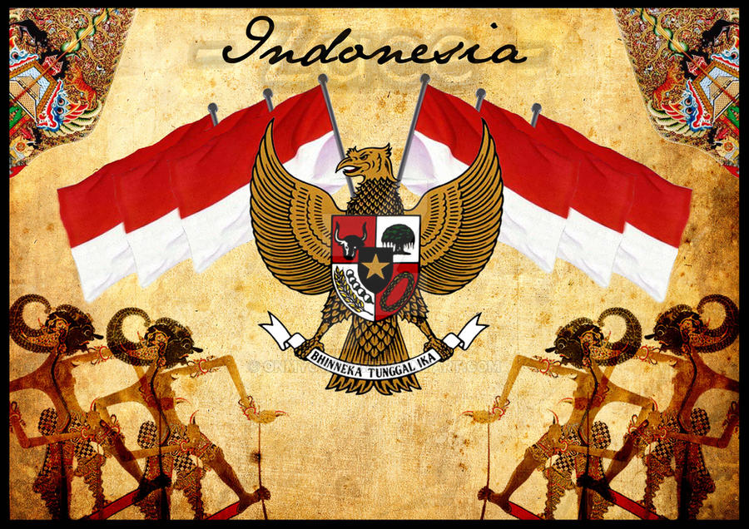
Pancasila as a Source of Character Education
Pancasila is the main source of education and development of civic character.
Pancasila consists of five basic values, namely divinity, humanity, unity, democracy (consultation), social justice.
The five basic values are the nation's view of life
This Photo by Unknown Author is licensed under CC BY-NC-ND

Slide 6
Learning Scopes
Session | Topics | Learning Outcomes
1 | Introduction: Pancasila as the Source of Character Education and State Ideology | to describe Pancasila as the source to develop the students’ characters and the state ideology
2 | The History of Pancasila (Before-After Independence, Old Era, New Era, Reform Era) | to describe Pancasila as the source to develop the students’ characters and the state ideology
3 | Pancasila and the World Ideologies (Pancasila-Liberalism Comparative, Pancasila-Communism Comparative) | to describe Pancasila as the source to develop the students’ characters and the state ideology
4 | Belief in God | to describe Pancasila as the source to develop the students’ characters and the state ideology
5 | Justice and Civilized Humanity | to describe Pancasila as the source to develop the students’ characters and the state ideology
6 | Indonesian Unity | to solve the social issues related to Indonesian unity, cultural interaction and Pancasila democracy
7 | Culture Interaction | to solve the social issues related to Indonesian unity, cultural interaction and Pancasila democracy
8 | Pancasila Democracy | to solve the social issues related to Indonesian unity, cultural interaction and Pancasila democracy
9 | Pancasila Leadership | to analyze the relationship between the Pancasila Leadership and Social Justice
10 | Social Justice | to analyze the relationship between the Pancasila Leadership and Social Justice
11 | Pancasila as the Ethical Basic in Developing Science and Technology | to compose group reflections on developing science and technology with Pancasila as the ethical basis and the implementation of Pancasila
12 | Anti Corruption | to design a project related to anti-corruption
13 | Implementation of Pancasila | to compose group reflections on developing science and technology with Pancasila as the ethical basis and the implementation of Pancasila

